Slide 1
“Time has come to implement IoT beyond home automation.” - unknown

Slide 2
Wow!!! It’s Barcamp Time
Tesco in mind
Power of IOT
Improve Customer Satisfaction

Slide 3



Slide 4
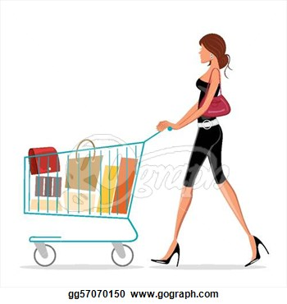
Why?

Slide 5


When?

Slide 6
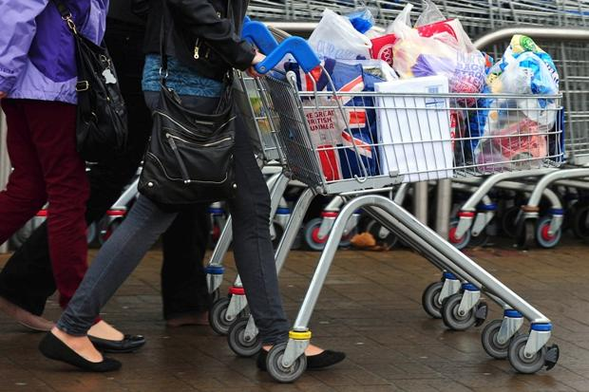
The Idea
Follow me Trolley

Slide 7
1. Shopper tells his location to the trolley ☺ 2. Trolley moves in that direction 3. Trolley stops whenever shopper stops or an obstacle arrives
How?

Slide 8










Left Wheel BO Motor
Right Wheel BO Motor
IoT Gateway
BO Motor Driver
SR 04 Ultrasonic Transducer Right Receiver
SR 04 Ultrasonic Transducer Left Receiver
Active Cart Express Checkout
ARDUINO UN0
Data Analytics
RFID Reader RFC 522
SR 04 Ultrasonic Transducer Obstacle Avoidance
Transmitter paired using LBE, HC-05
Shopping Floor

Slide 9
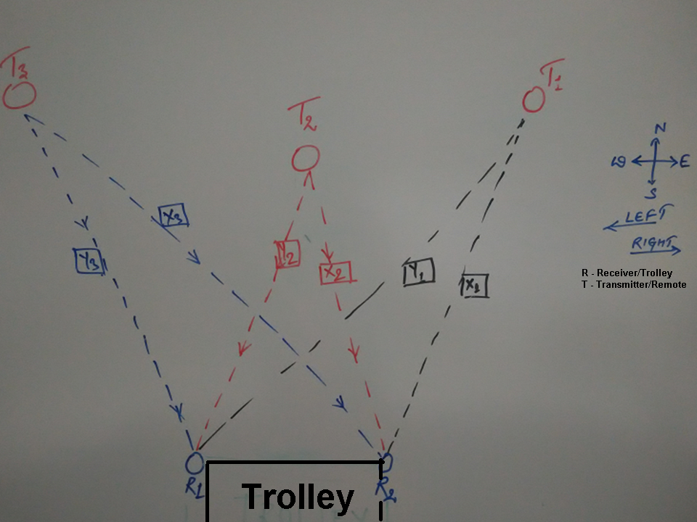

Slide 10
List of failures
Sounds Easy, eh?
Wifi Module | ESP-01 (ESP 8266) | Command works. Doesn’t work from code
GPS | NEO6MV2 | Doesn’t work inside store
Ultrasound generic sensor | SR04 | No separate receive or transmit feature
Bluetooth | HC-05 | Delay in receiving
------------------------------ |  | Almost quit

Slide 11
There’s More?? ☺

Slide 12
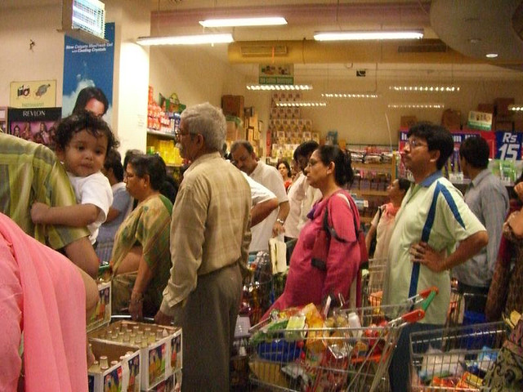

Slide 13
1. Shopper dumps product in trolley 2. Product gets added to customer’s cart. 3. No checkout queue. 4. Customer arrives at self payment kiosk. 5. Shopping Done!!!
Auto checkout of Products

Slide 14
Want to hack this prototype?

